Slide 1
Big Data Analytics Solution Enhancing Decision-Making with Cloud Computing and Machine Learning
(CS 651 03) Cloud Computing & Big Data Analytic 2024 FA
To: Professor Steven Thomas
Notes:
Entered text
Slide 1: Title Slide
Title: Big Data Analytics Solution for Optimized Decision-Making
By: Ankit Bharti
Slide 2: Problem Statement
Businesses face challenges in processing and analyzing massive datasets. These datasets, ranging from customer feedback to operational logs, need to be analyzed quickly to derive insights. The objective of this project is to build a data-driven solution using cloud computing tools and machine learning models to enhance decision-making processes, improve customer experiences, and drive operational efficiency.
Slide 3: Data Collection Strategy (Project 2)
Data Sources:
- Customer Feedback: Extracted from product reviews and social media.
- E-commerce Transactions: Information gathered from sales records.
- IoT Sensor Data: Collected from electronic devices (Samsung simulation).
Format & Storage:
- Data stored in CSV, JSON, and Parquet formats.
- Azure Blob Storage was used for scalable, cloud-based storage of large datasets.
Slide 4: Data Ingestion Pipeline (Project 2)
I set up an automated data ingestion pipeline using Microsoft Azure Data Factory. The pipeline:
- Ingests customer reviews, sales data, and IoT logs.
- Cleanses and validates incoming data streams.
- Stores clean data in Azure Blob Storage for further processing.
Slide 5: Data Processing with Apache Spark (Project 3)
Framework: Apache Spark (via Azure Databricks)
Data processing included:
- Cleaning: Removal of null values and duplicates.
- Transformation: Parsing complex JSON structures.
- Aggregation: Calculated key metrics like customer sentiment and monthly sales trends.
Optimized Spark jobs by distributing the load across multiple nodes to handle the dataset efficiently.

Slide 2
Index
Introduction
Problem Statement
Data Collection Strategy
Data Ingestion Pipeline
Data Processing with Apache Spark
Data Storage & Management Strategy
Exploratory Data Analysis
Interactive Data Visualizations
Challenges & Solutions
Key Insights & Findings
References
Summary of Presentation

Slide 3
Introduction
Objective: The primary goal of this project is to build a comprehensive big data analytics solution that leverages cloud computing and machine learning to solve real-world business challenges.
Scope: Throughout the project, we worked on:
Designing data ingestion pipelines.
Implementing data storage solutions.
Processing and transforming large datasets for analysis.
Technologies and Tools: The solution is built using Microsoft Azure, Apache Spark, Power BI, Azure Cosmos DB, and Python to handle big data processing and machine learning tasks in a scalable cloud environment.
Expected Outcomes:
Streamlined data processing through cloud-based pipelines.
Interactive visualizations to communicate key findings effectively.
Key Insights for the Stakeholders to take decision.

Slide 4
Problem Statement
Businesses today face significant challenges in processing and analyzing massive datasets. These datasets, which include customer feedback and operational logs, need to be analyzed quickly to derive valuable insights. The objective of this project is to build a data-driven solution that leverages cloud computing tools and machine learning models to enhance decision-making processes, improve customer experiences, and drive operational efficiency.

Slide 5

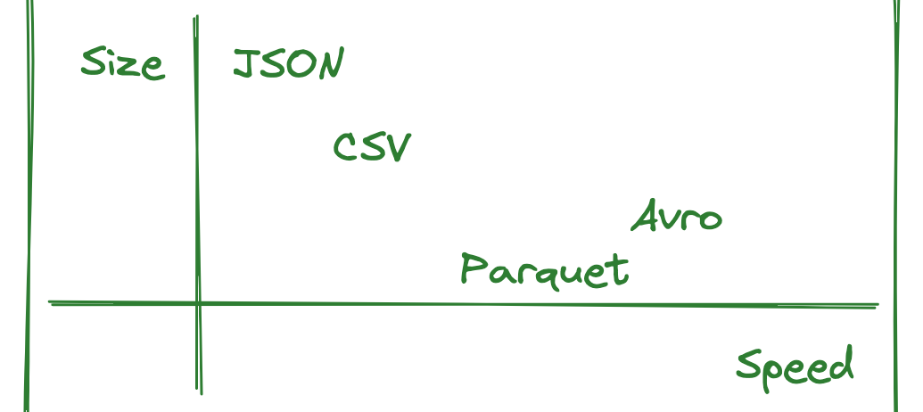
Data Collection Strategy
Data Sources
Format & Storage
Customer Feedback: Extracted from product reviews and social media platforms. E-commerce Transactions: Information gathered from sales records. IoT Sensor Data: Collected from electronic devices (Samsung simulation).
- Data is stored in CSV, JSON, and Parquet formats.
- Azure Blob Storage is utilized for scalable, cloud-based storage of large datasets.

Slide 6
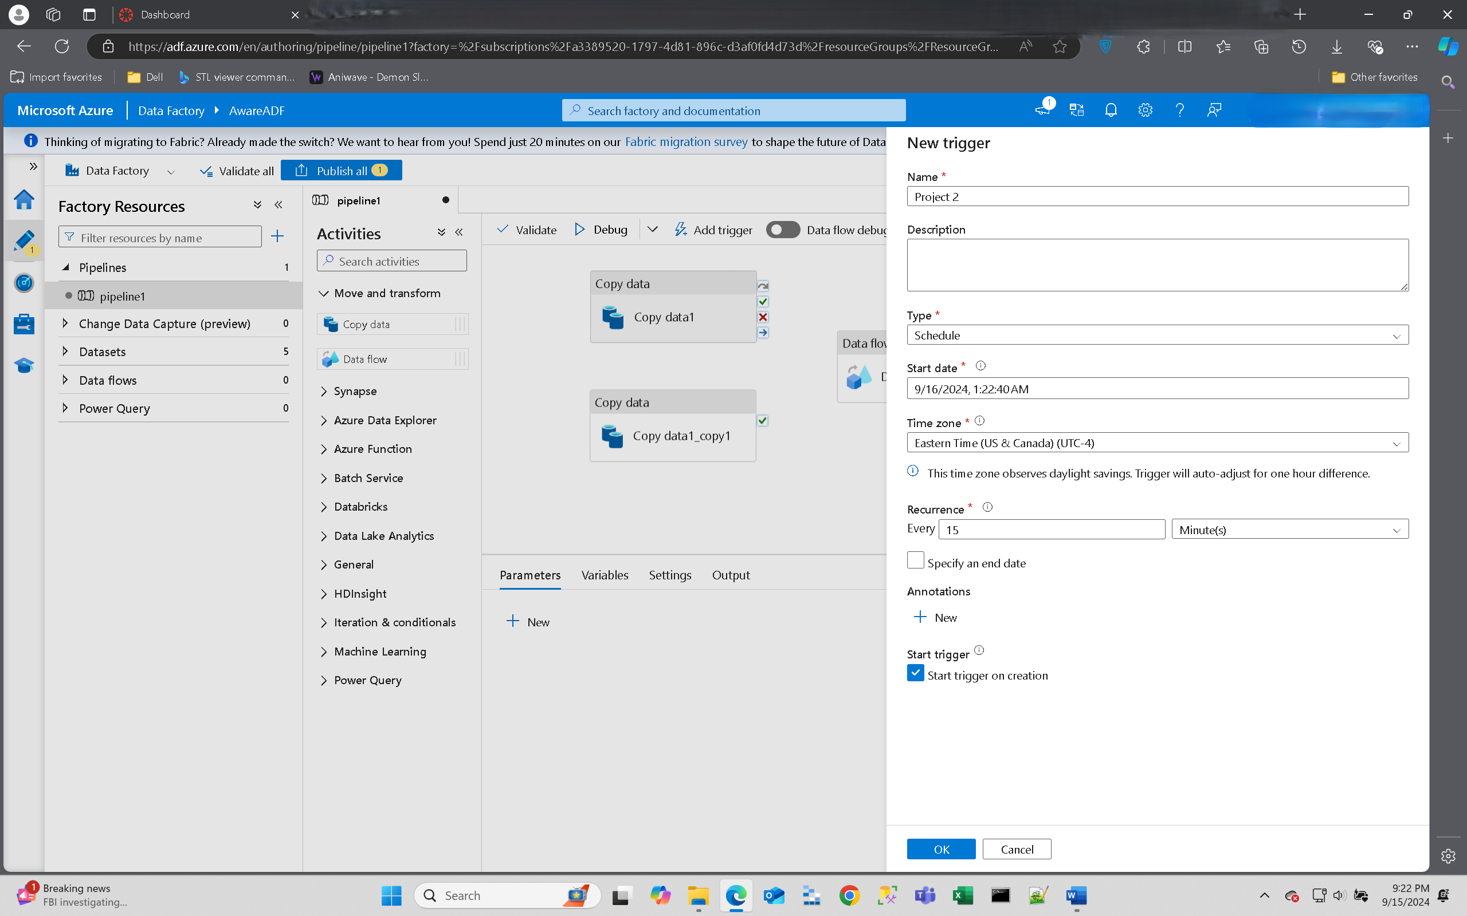
Data Ingestion Pipeline
To streamline the data ingestion process, an automated data ingestion pipeline was implemented using Microsoft Azure Data Factory. This pipeline performs the following- tasks:
Ingests customer reviews, sales data, and IoT logs.
Cleanses and validates incoming data streams.
Stores clean data in Azure Blob Storage for further processing.

Slide 7
Data Processing with Apache Spark
The data processing phase of the project involves utilizing the Apache Spark framework, specifically through Azure Databricks. The following steps were undertaken:
Cleaning: Removal of null values and duplicates to ensure data quality.
Transformation: Parsing complex JSON structures for further analysis.
Aggregation: Calculation of key metrics such as customer sentiment and monthly sales trends. Optimized Spark jobs were implemented to efficiently handle the dataset across multiple nodes, ensuring timely processing and analysis.

Slide 8
Data Storage & Management Strategy
Utilized Azure Cosmos DB, a NoSQL database, for scalable storage and fast querying. Key decisions included enabling Automatic Indexing for fast queries on large datasets and implementing sharding to efficiently distribute data across partitions. This strategy allowed for efficient handling of large datasets and ensured efficient data retrieval.
Data Governance & Compliance
Data Classification:
Azure Purview: Unified data governance solution for data classification, management, and cataloging.
Data Stewardship:
Data Catalog: Maintains an inventory of data assets for discovery and trust.
Policies and Standards: Establishes consistent data management practices.
Data Lifecycle Management:
Blob Storage Lifecycle Management: Automates data management based on its lifecycle (archiving, tiering).
Retention Policies: Defines how long data is retained before deletion or archiving.
Access Control and Security:
Role-Based Access Control (RBAC): Manages access to resources based on user roles.
Azure Active Directory: Secures user identities with access management and multi-factor authentication.

Slide 9
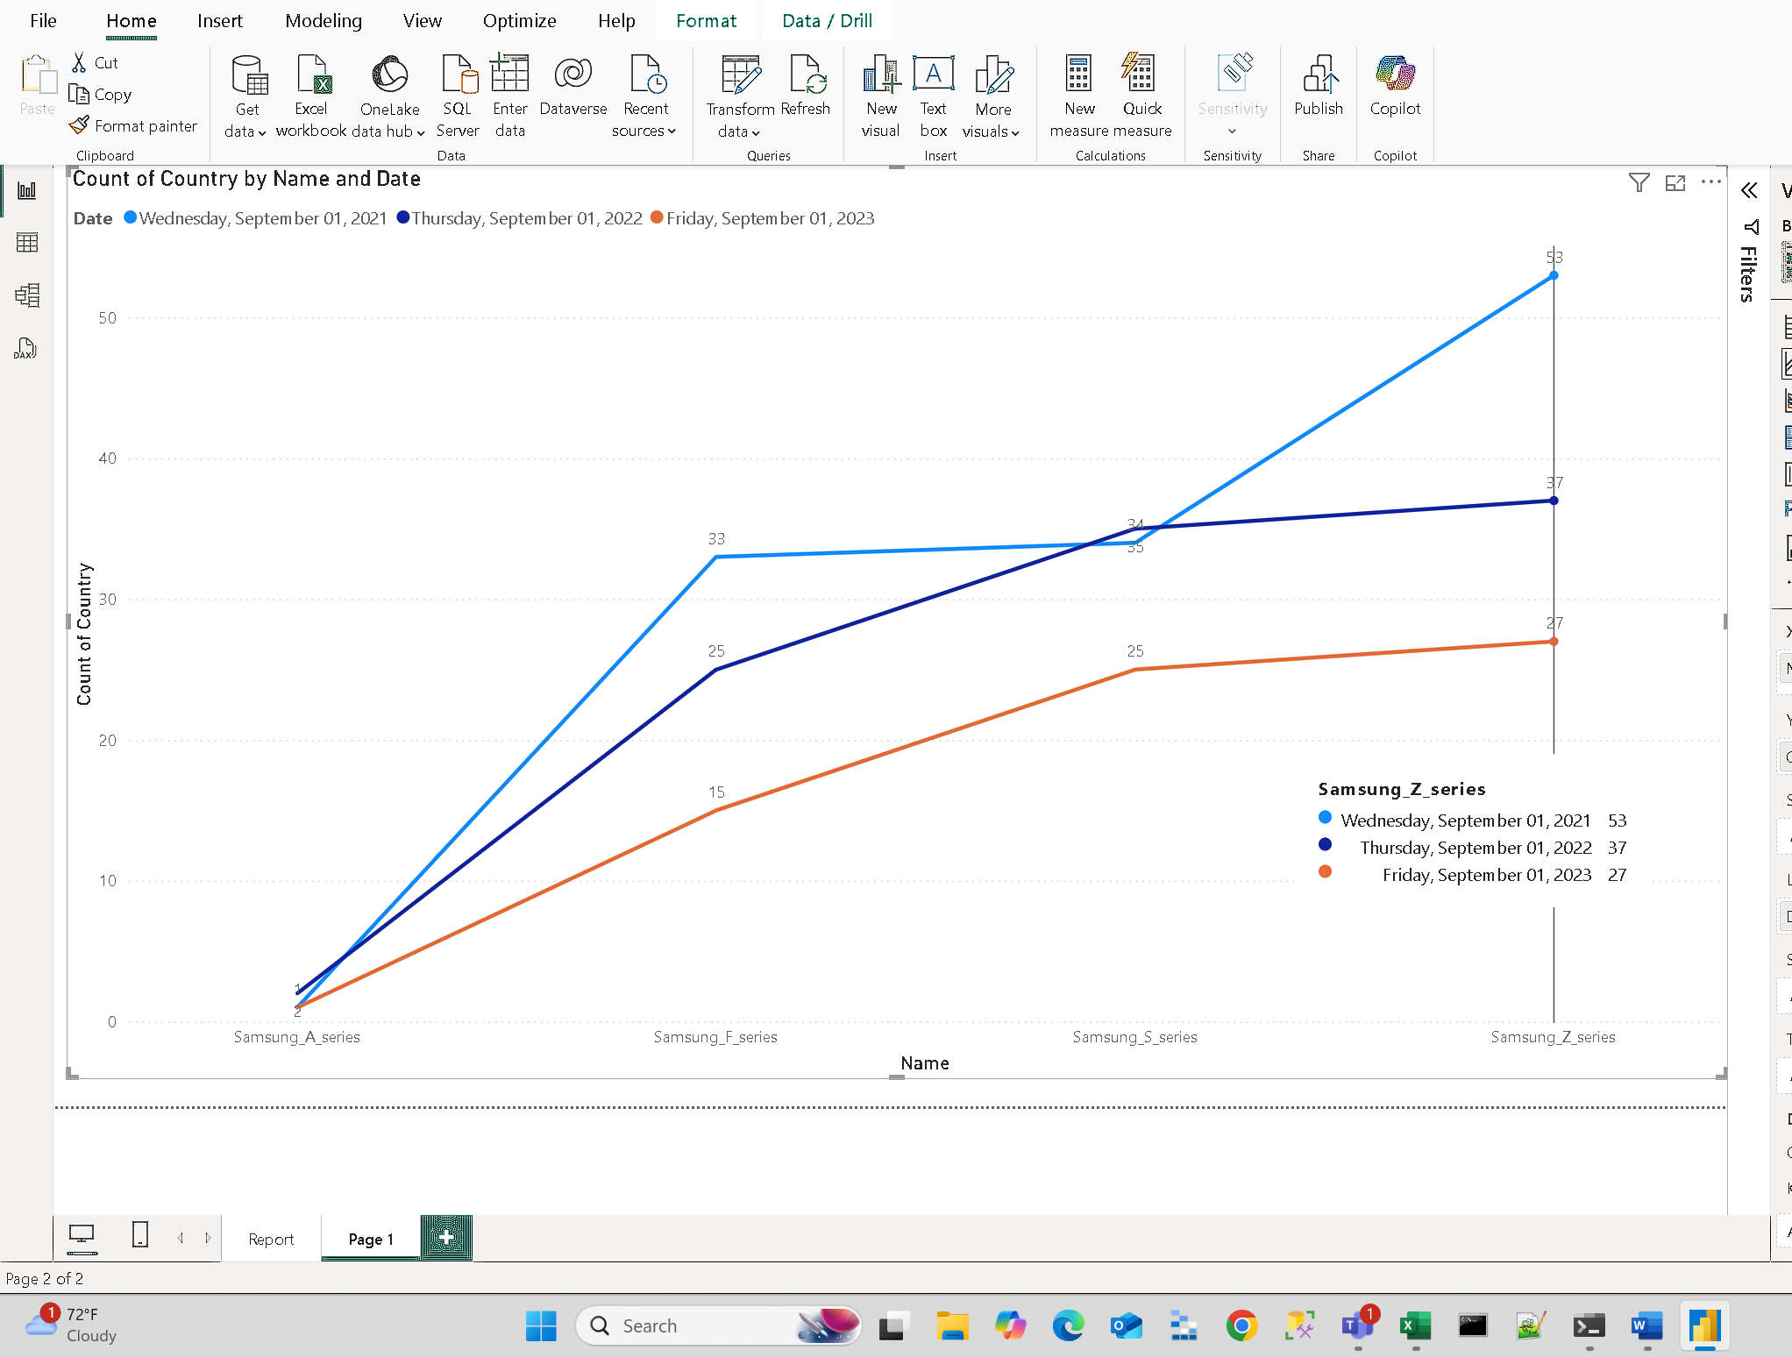
Exploratory Data Analysis
Utilized Apache Spark for exploratory data analysis (EDA). Conducted Customer Sentiment Analysis by analyzing product reviews to gauge customer satisfaction. Also performed Sales Trend Analysis to identify peak sales periods and customer purchasing behavior. These insights highlighted the need for better inventory management and customer service.

Slide 10
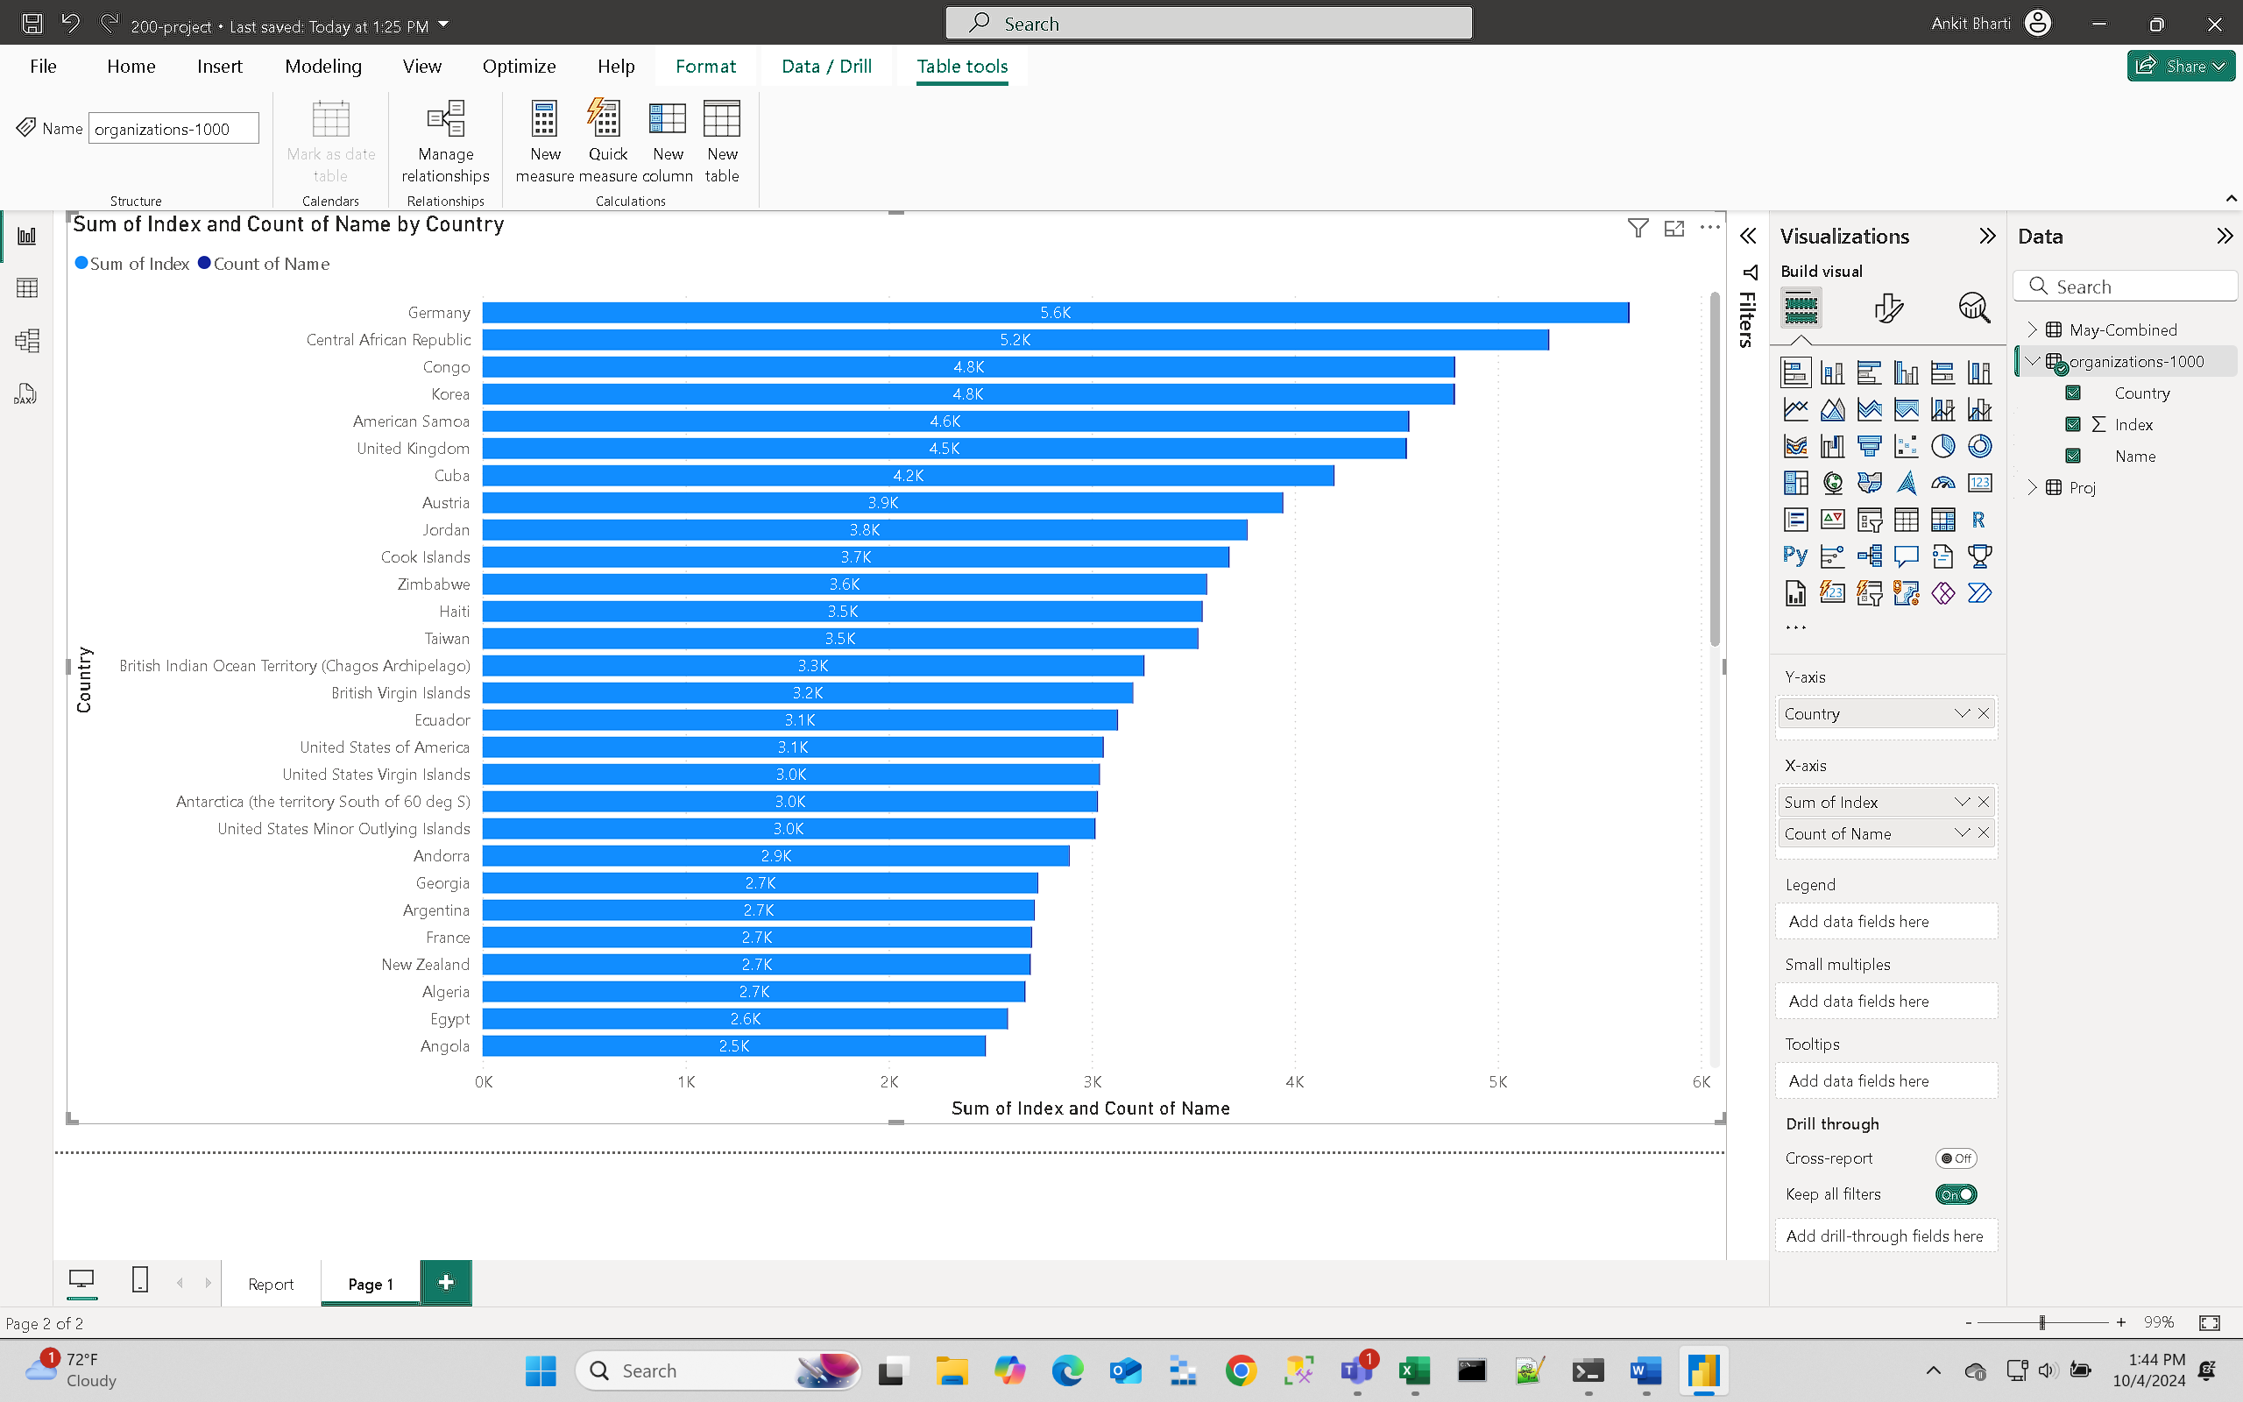
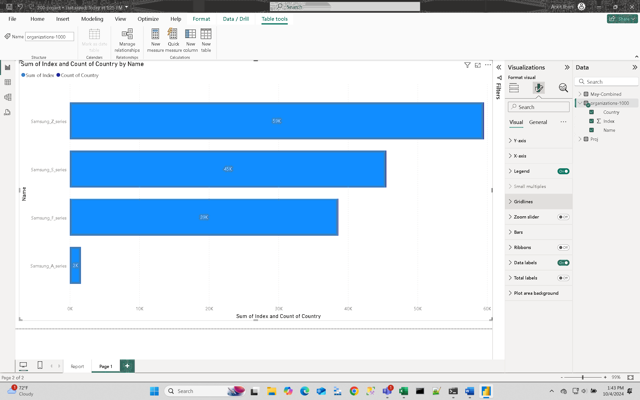
Interactive Data Visualizations
Created dashboards using Power BI to visualize key metrics. Developed Sales Performance Dashboards to show trends in sales in different countries and models. These interactive dashboards allowed senior management to monitor product performance and sales trends effectively and in which region to focus.

Slide 11

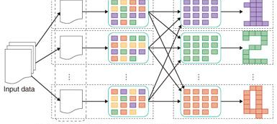
Challenges & Solutions
Challenges Faced During the Project
Proposed Solutions to Overcome Challenges
Leveraging Azure Cosmos DB and Azure Databricks to ensure scalability and accommodate large-scale datasets in real-time.
Fine-tuning the machine learning models in Spark's distributed environment to optimize performance and accuracy.
Handling Large-Scale Datasets in Real-Time
Tuning Machine Learning Models for Performance and Accuracy

Slide 12
Key Insights & Findings
Customer Sentiment Analysis: The project enabled early identification of product issues through sentiment analysis, allowing for timely intervention and improved customer satisfaction.
Sales Forecasting: Data-driven insights obtained through sales forecasting provided valuable information for inventory and sales planning, leading to more efficient operations.
Insights from the Project
Impact of the Project
The project significantly improved decision-making across departments by providing actionable insights derived from sentiment analysis and sales forecasting.
Enhanced product strategies and resource allocation were achieved through the implementation of data-driven approaches, resulting in improved business outcomes.

Slide 13
Summary of Presentation
In summary, this presentation covered the data storage and management strategy, exploratory data analysis insights, interactive data visualizations and analysis, key findings & insights, and challenges developed in various projects.
The utilization of modern technologies and techniques allowed for efficient data handling.
Valuable insights were gained from the data analysis.
Informed decision-making was achieved through the developed models.

Slide 14
References
Microsoft Azure. (n.d.). What is cloud computing? Retrieved from https://azure.microsoft.com/en-us/resources/cloud-computing-dictionary/what-is-cloud-computing/
Microsoft Azure. (n.d.). Azure compliance documentation. Retrieved from https://azure.microsoft.com/en-us/overview/trusted-cloud/compliance/
Microsoft Azure. (n.d.). Azure security documentation. Retrieved from https://learn.microsoft.com/en-us/azure/security/
Rittinghouse, J. W., & Ransome, J. F. (2017). Cloud computing: Implementation, management, and security. CRC Press.
Katal, A., Wazid, M., & Goudar, R. H. (2023). Big data: Issues, challenges, tools and good practices. Journal of Computer Sciences and Applications, 5(2), 47-57.

Slide 15
Thank You
Notes:
Entered text
Slide 1: Title Slide
Title: Big Data Analytics Solution for Optimized Decision-Making
By: Ankit Bharti
Slide 2: Problem Statement
Businesses face challenges in processing and analyzing massive datasets. These datasets, ranging from customer feedback to operational logs, need to be analyzed quickly to derive insights. The objective of this project is to build a data-driven solution using cloud computing tools and machine learning models to enhance decision-making processes, improve customer experiences, and drive operational efficiency.
Slide 3: Data Collection Strategy (Project 2)
Data Sources:
- Customer Feedback: Extracted from product reviews and social media.
- E-commerce Transactions: Information gathered from sales records.
- IoT Sensor Data: Collected from electronic devices (Samsung simulation).
Format & Storage:
- Data stored in CSV, JSON, and Parquet formats.
- Azure Blob Storage was used for scalable, cloud-based storage of large datasets.
Slide 4: Data Ingestion Pipeline (Project 2)
I set up an automated data ingestion pipeline using Microsoft Azure Data Factory. The pipeline:
- Ingests customer reviews, sales data, and IoT logs.
- Cleanses and validates incoming data streams.
- Stores clean data in Azure Blob Storage for further processing.
Slide 5: Data Processing with Apache Spark (Project 3)
Framework: Apache Spark (via Azure Databricks)
Data processing included:
- Cleaning: Removal of null values and duplicates.
- Transformation: Parsing complex JSON structures.
- Aggregation: Calculated key metrics like customer sentiment and monthly sales trends.
Optimized Spark jobs by distributing the load across multiple nodes to handle the dataset efficiently.

